Slide 1

DC/DC-Converter Version 9-3
Scrutineering Support Presentation
This document is for reference only! If used for scrutineering, replace the pictures and videos with your own build and test-Setup (and everything that differs from the official build)!
This Document follows the Inspection Sheet (FSG 2024).
Index:
Converter Specifications
Sufficient spacing regarding system voltage and implementation
Sufficient insulation
Temperature rating of coating if used, datasheet available. Coating process according to datasheet
Rating of Fuses and Connectors
Further Documents
Converter Schematic
Converter Overview
compliance with Rules
All Project Files: Here
DC/DCv9-3 Data Sheet: Here
Documentation: Here
Build guide: Here
Contact:
Rootthecause
Date: January 26th 2025

Slide 2
Converter Specifications
Input Voltage range | 200 - 600 | V
Output Voltage (regulated) | 24 | V
Typ. Output Power | 500 | W
Peak Output Power (60 seconds) | 750 | W
Max. Efficiency | 96.9 | %
Size (L x W x H) | 85.6 x 54 x 45 | mm
Features:
Under-/Overvoltage Protection (206 V / 609 V)
Solid state constant Current Pre-Charge
Passive Discharge with HV indicator LED
low EMI Resonant LLC Topology
Super Capacitor for isolated start-up with self recharge
Over temperature Shutdown
Temperature controlled Fan

Slide 3
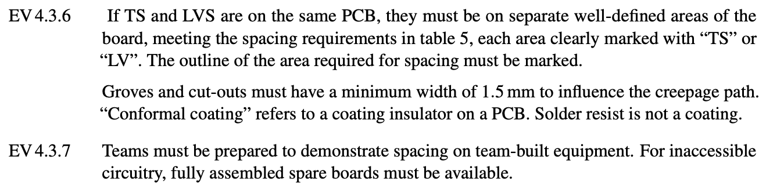
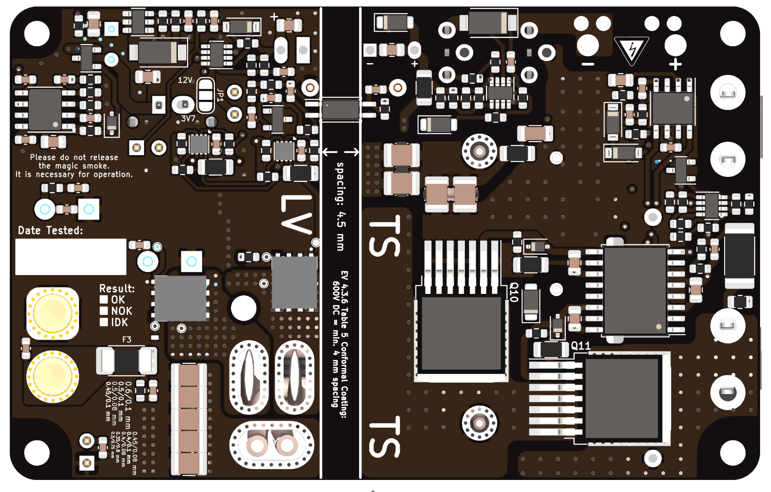
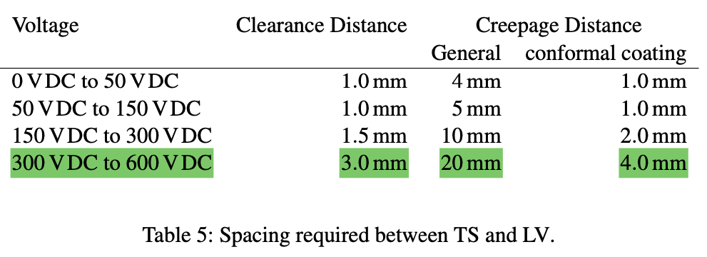
Sufficient spacing
The maximum TS-Voltage is 600V and conformal Coating (Plastik 70) is used.
→ Required Spacing is 4.0 mm according to EV 4.3.6
→ minimum Spacing on PCB is 4.5 mm
- PCB breakdown Voltage: ≥ 40 kV see Datasheet
LV Spacing TS
Source: Formula Student Rules 2025 v1.1
Bottom View

Slide 4
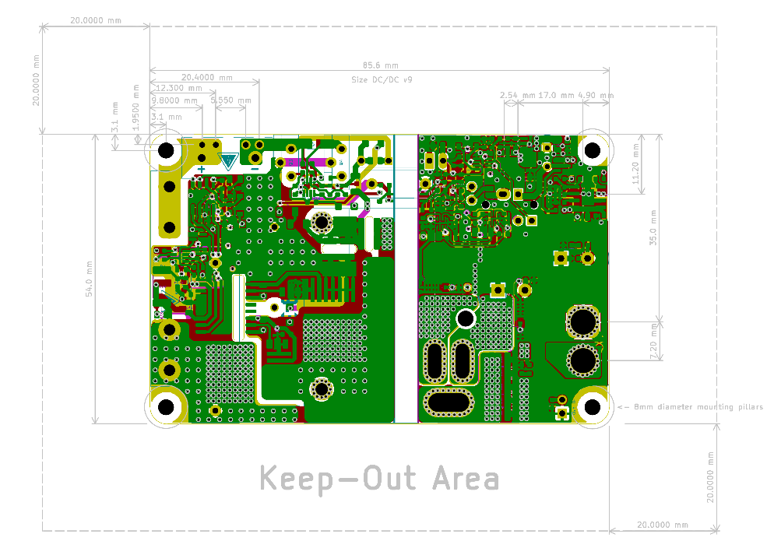
Sufficient spacing (PCB Layer View)
TS
LV
Spacing 4.5 mm

Slide 5
Sufficient insulation
The Following Components are in between TS and LV
Designator | Function | max. Working Voltage (RMS) | Isolation Voltage (RMS) | Prod. no. & Datasheet
C4 | Y-Capacitor | 1500 V | 4000 V | VY1332M59Y5 UQ63V0 https://www.mouser.de/ProductDetail/Vishay-BC-Components/VY1332M59Y5UQ63V0?qs=YhDfSRCt1jSxb5NtHMih%252Bg%3D%3D
U1 | 1 W support DC/DC | not applicable | 3000 V | TBA 1-1212HI https://www.mouser.de/ProductDetail/TRACO-Power/TBA-1-1212HI?qs=byeeYqUIh0N5pnK9BA%252B2og%3D%3D
U9 | Feedback Optocoupler | not applicable | 3750 V | ACPL-217-50AE https://www.mouser.de/ProductDetail/Broadcom-Avago/ACPL-217-50AE?qs=dcm2zoLQumB4Kh%252BCZrN57A%3D%3D
T1 | 28:2:2 HF-Transformer | not applicable | 3000 V | Coil 67+68+69 https://github.com/Rootthecause/DCDC/blob/main/documentation/Datasheet_DCDCv9-3.pdf Page 8
T1 is self developed → see next page for details

Slide 6
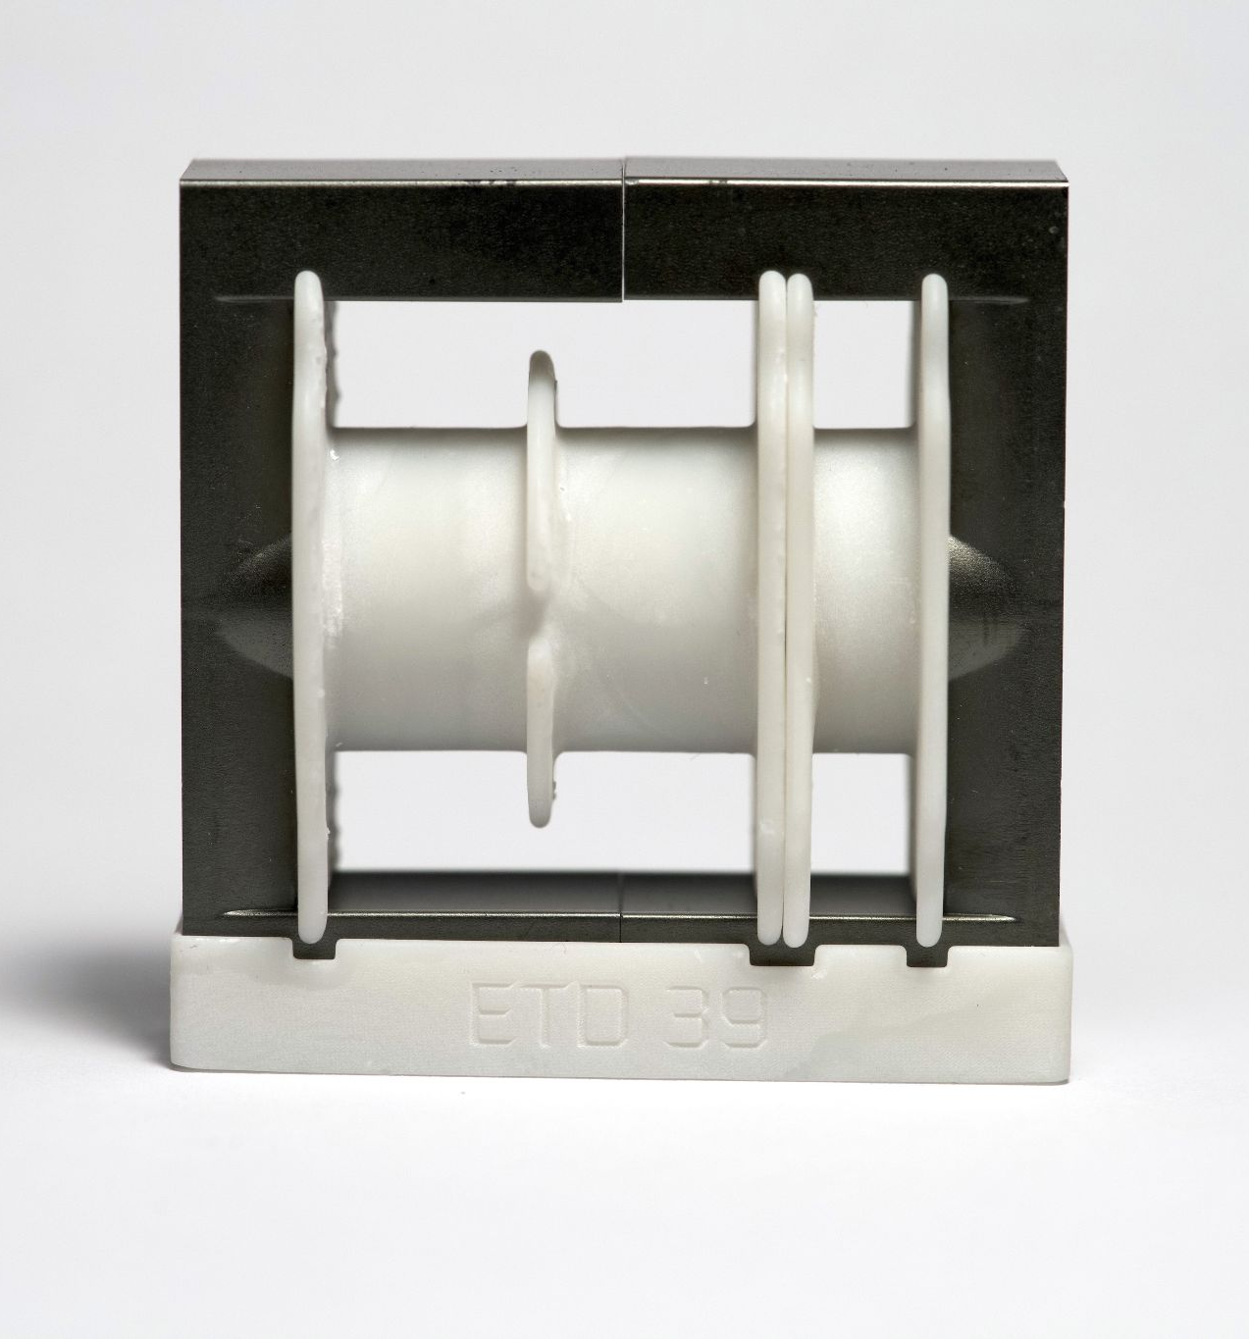
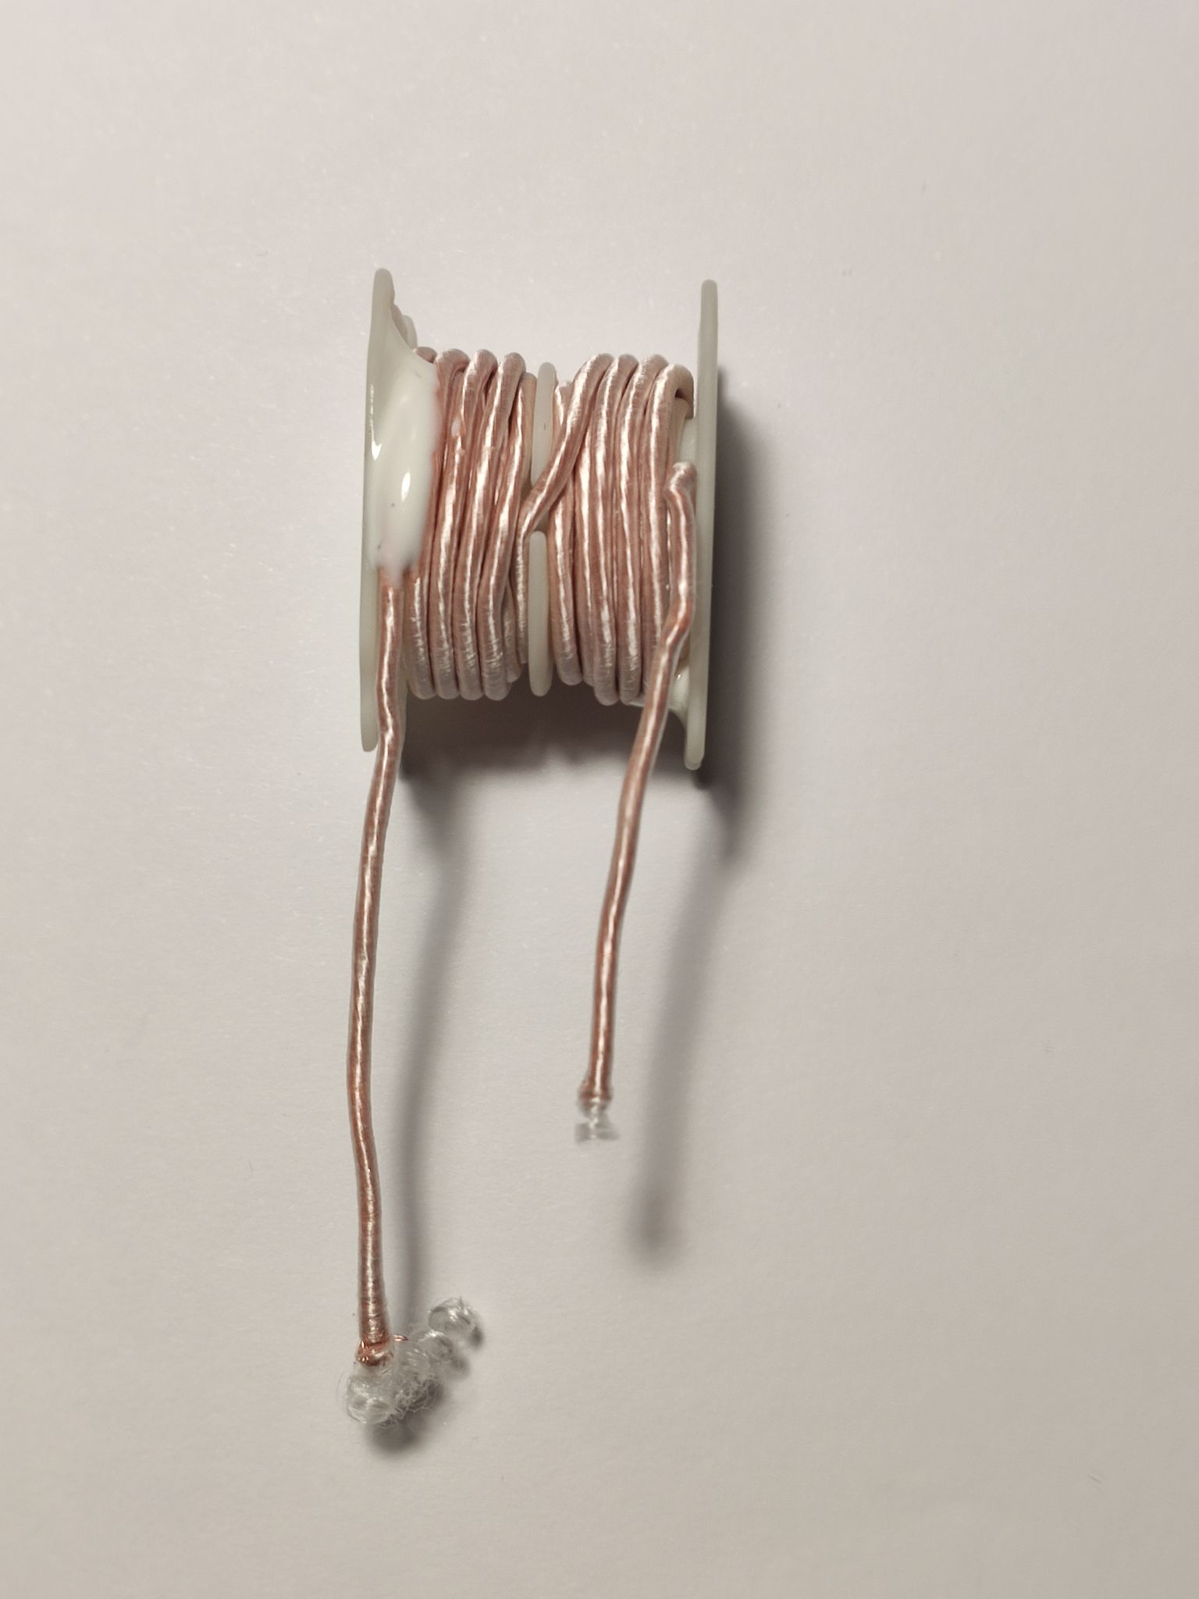
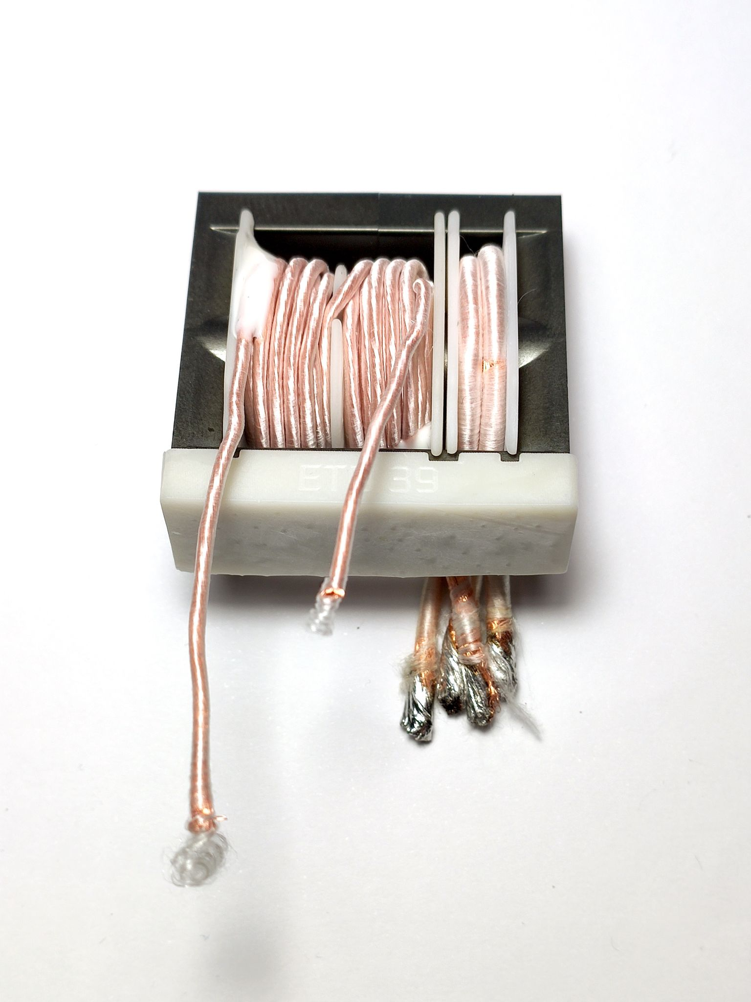
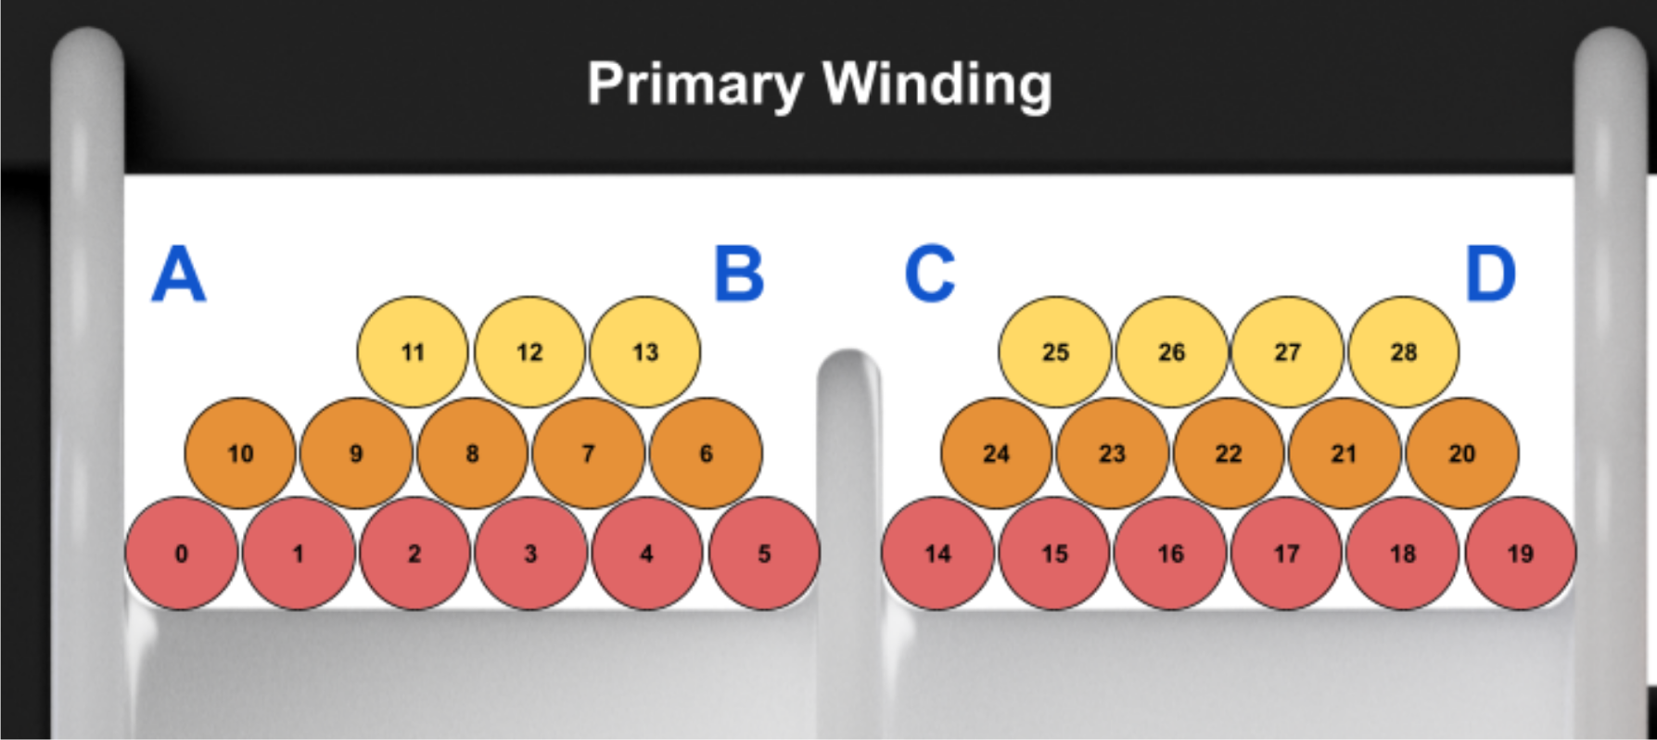
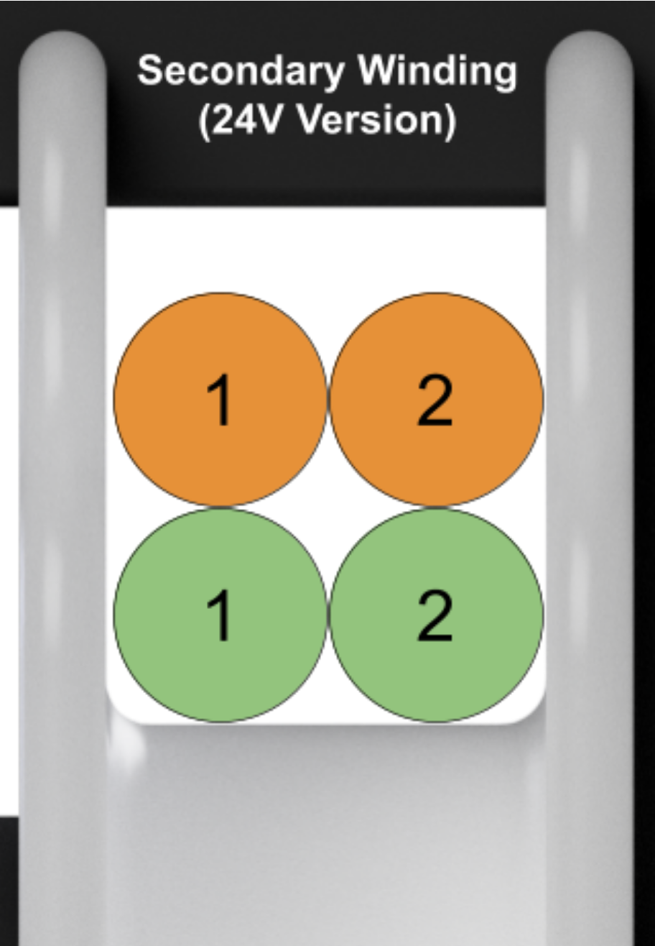
Transformer construction
Ferrite cores are inserted and glued together with 3M™ Scotch-Weld™ DP100FR.
Coil formers and the Isolator (bottom) are 3D-Printed with
UL94-V0 Resin (Liqcreate FR HDT).
28 Turns of enamelled copper litz wire are wound onto the primary coil former.
The protruding connections of the primary winding are reinforced with shrink tubing (not shown in this picture).
2 Turns for each secondary are wound onto the secondary coil former.
See next page for material certification!

Slide 7
Transformer Materials
Part | Material | Specification | Datasheet
Coil Former and Isolator | Liqcreate Flame Retardant HDT SLA Resin | UL94V-0 HDT at 0.45 MPa: 237°C | https://3d.nice-cdn.com/upload/file/TDS_Liqcreate_Flame_Retardant_HDT_V1_16-10-2023_.pdf
Kapton® | Kapton® MT 0.05 mm | UL94V-0 / Breakdown Voltage ≥ 7 kV | https://shop.cmc.de/documents/file/pdf/70791.pdf
Litz Wire Prim / Sek | Enamelled copper wire 120 x 0.1 mm / 600 x 0.071 mm | Breakdown Voltage ≥ 500 V (See note) IEC 60085 Thermal class B (130°C) | https://www.ebay.de/itm/304154052959?hash=item46d0fe895f
Epoxy Glue | 3M™ Scotch-Weld™ DP100FR | UL94V-0 | https://www.3mdeutschland.de/3M/de_DE/p/d/b40066500/
Ferrite Cores | MnZn (N97) | - | https://www.tdk-electronics.tdk.com/inf/80/db/fer/etd_39_20_13.pdf
Note: Since the coil former is used as primary Isolation, the Litz wire rating is sufficient.
At 600 V input, the Voltage per turn of winding is < 25 V, which is sufficient.
In addition to the Isolator, a layer of Kapton® in between the Transformer and the PCB is used to isolate the Ferrite cores between TS and LV

Slide 8
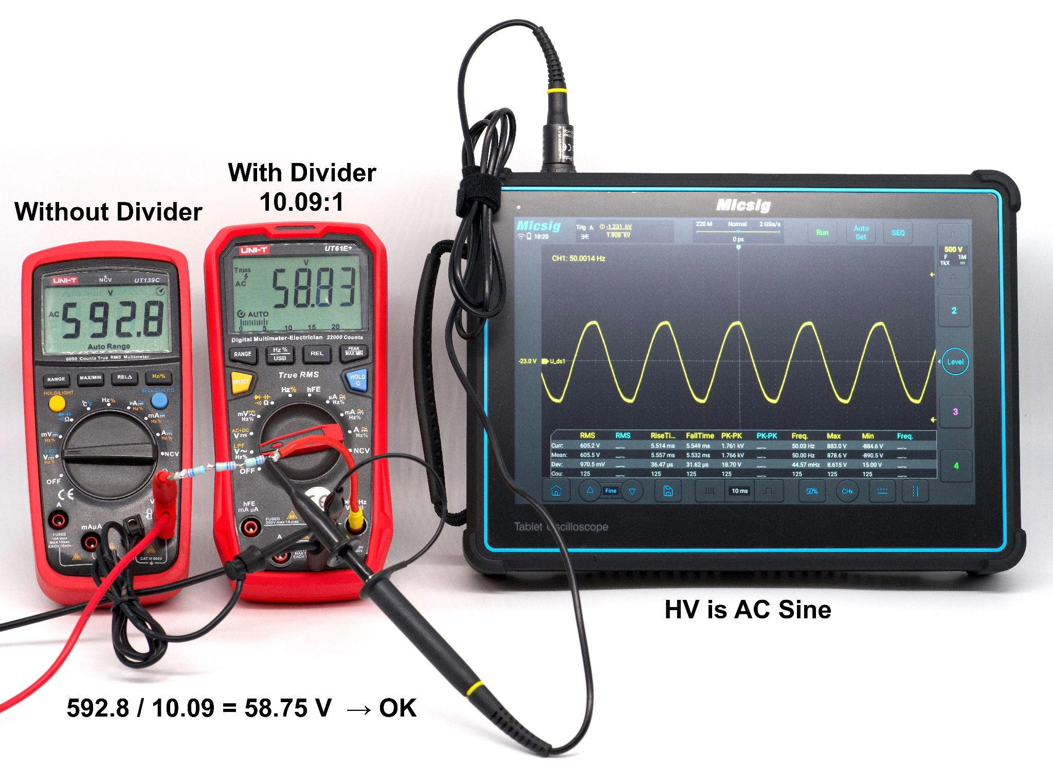
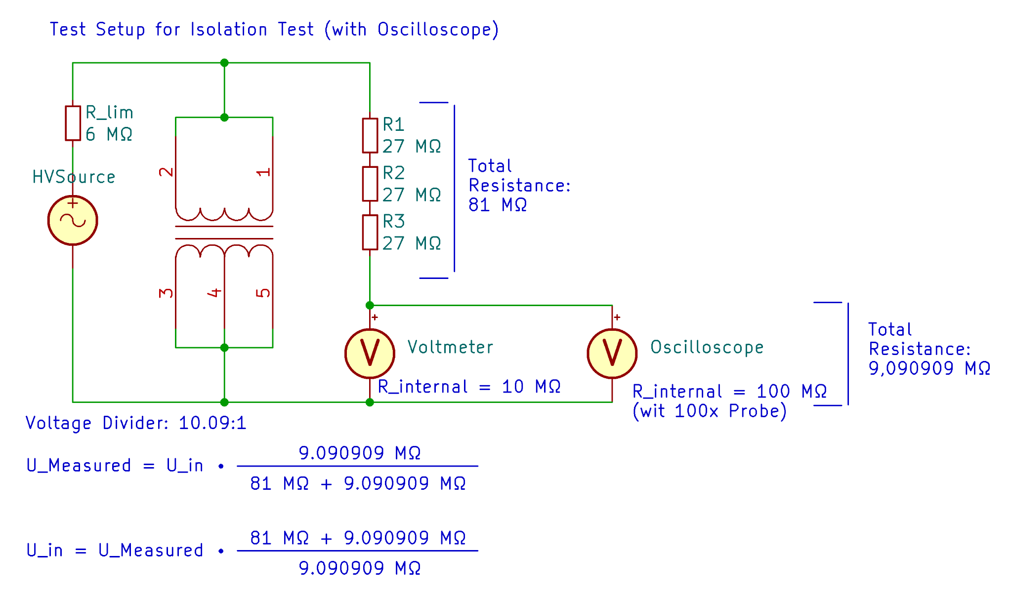
Transformer Isolation Test - proof of Test Devices (AC)
A 10.09:1 Voltage Divider is used to measure the Isolation Test Voltage (Multimeter readings need to be multiplied by 10.09).
The High Voltage source is 50 Hz AC. When a breakdown occurs, the sound of it is audible.
In addition, an oscilloscope is used to show breakdowns by triggering on sudden voltage drops.

Slide 9
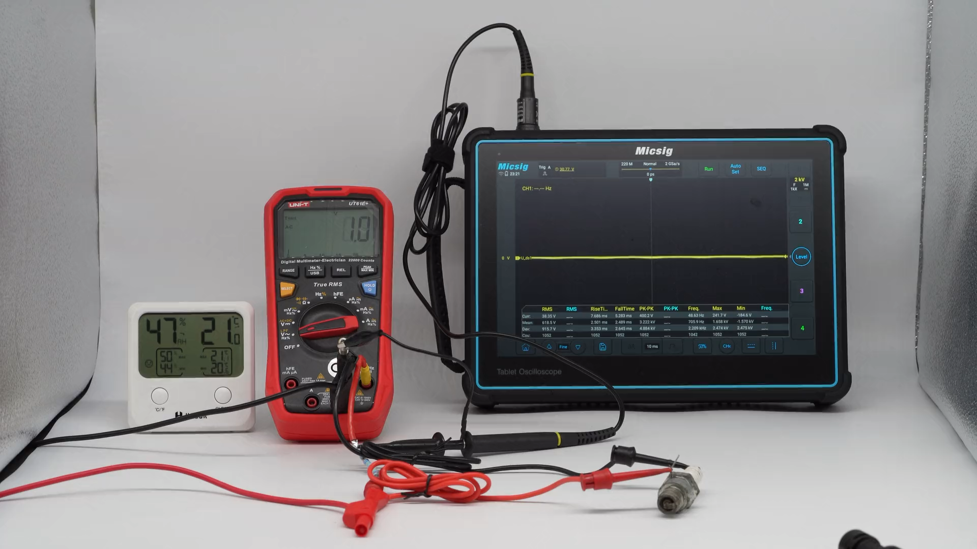
Isolation Test Breakdown Demonstration
The following Video demonstrates the behavior during a breakdown across a small air gap.
Please make sure that the Speakers are on.

Slide 10
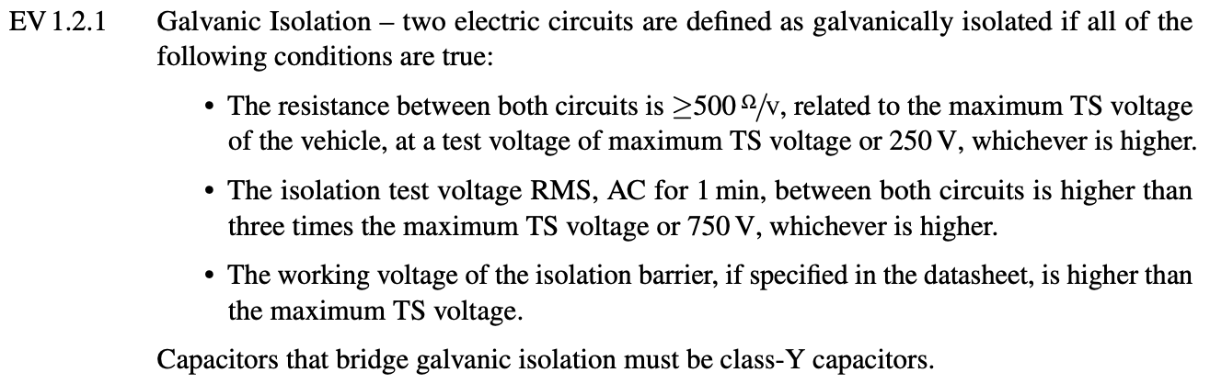
Transformer Isolation Test (AC) Video
This Test is in compliance with EV 1.2.1
The maximum TS Voltage is 600 V → Test Voltage must be ≥ 1800 V AC
3000 V (AC RMS, 50 Hz) are applied in between the Transformer Primary and Secondary Coils.
After one Minute, no breakdown was detected → Test passed.
(Video is on the next Page)
Source: Formula Student Rules 2025 v1.1

Slide 11
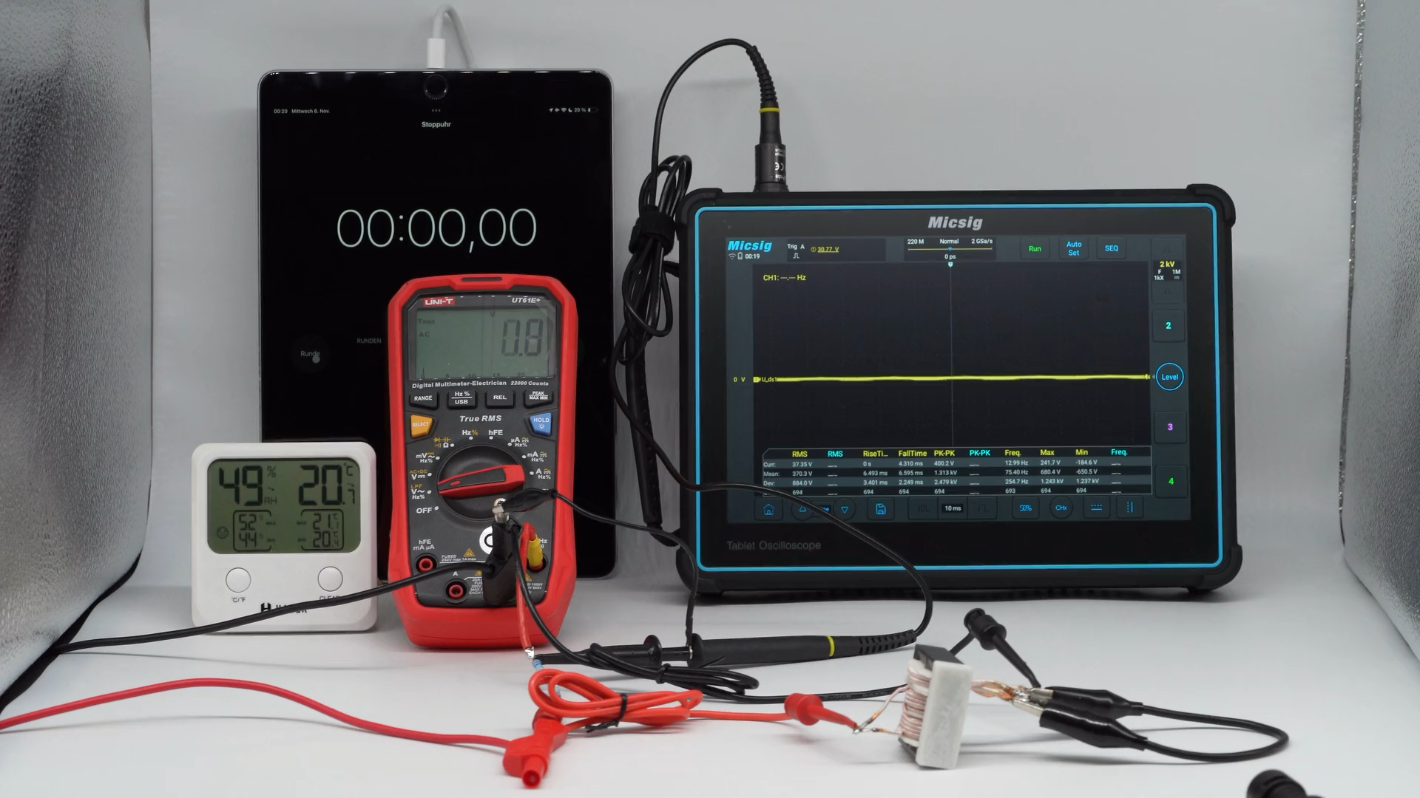
Transformer Isolation Test (AC) Video

Slide 12
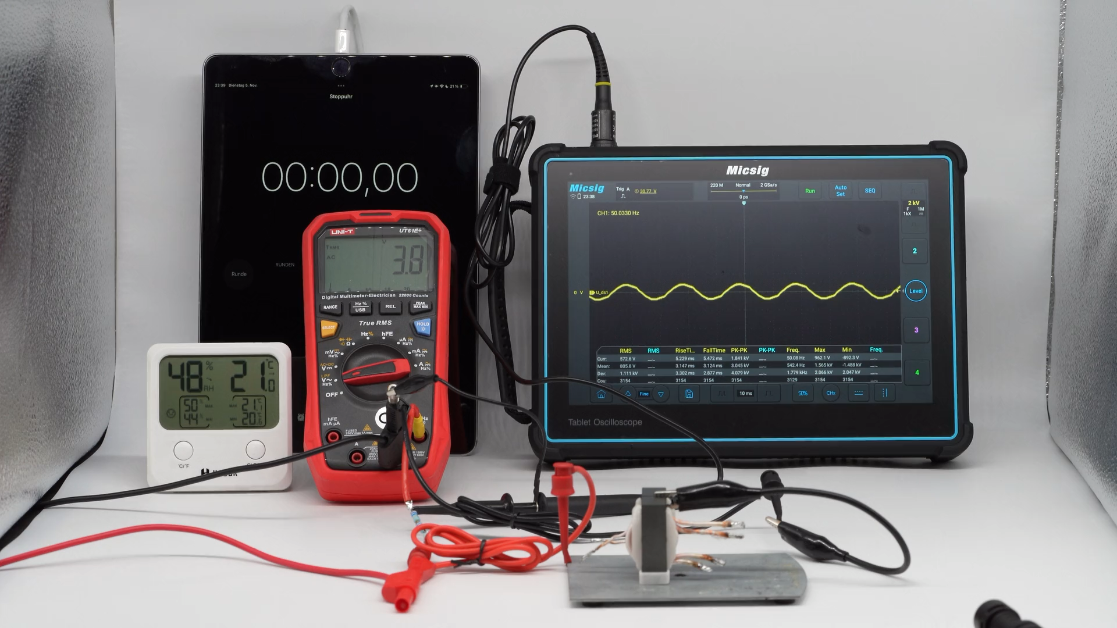
Isolator Isolation Test (AC) Video

Slide 13
Rating of Fuses and Connectors
Part | Function | Rating | Prod. no. & Datasheet
F1 | HV Input Fuse Input Voltage ≤ 600 V | 1.6 A / 1000 V DC / Fast (lower current ratings are also permitted) | 0ADBC1600-BE https://eu.mouser.com/ProductDetail/Bel-Fuse/0ADBC1600-BE?qs=rrS6PyfT74ehcAOXmfXChA%3D%3D
F2 | Internal LV Fuse (24 V) | 0.5 A / 125 V DC / Fast (current ratings up to 1 A are also permitted) | 0154.500DR https://www.mouser.de/ProductDetail/Littelfuse/0154.500DR?qs=gu7KAQ731URctJS76sTUdA%3D%3D
F3 | LV Output Fuse Output Voltage = 24 V | 20 A / 125 V DC / Fast (lower current ratings are also permitted) | 0679L9200-01 https://www.mouser.de/ProductDetail/Bel-Fuse/0679L9200-01?qs=ZqXcJfGlKsj4oTNRI%252B0pHw%3D%3D
J1 | HV Input connector (Plug) Input Voltage ≤ 600 V | 15 A / 600 V DC | 284051-2 https://www.mouser.de/ProductDetail/TE-Connectivity/284051-2?qs=OYEvAappxlxBiuwfKz%2FgFA%3D%3D
J1.1 | HV Input connector (Socket) Input Voltage ≤ 600 V | 15 A / 600 V DC | 282828-2 https://www.mouser.de/ProductDetail/TE-Connectivity/282828-2?qs=%2FmCiCROZvxYuPZyQ6f5T0w%3D%3D
J2 / J2.1 | LV Out (Plug & Socket) Output Voltage = 24 V | 30 A continuous 60 A Peak / 500 V DC | XT60 https://docs.rs-online.com/4610/A700000008956683.pdf

Slide 14
Coating process
Plastik 70 is used as conformal coating, Datasheet
one layer of coating is applied
coating process was applied according to datasheet:
20-30 cm Spray distance, 20 minutes drying time
Temperature Rating: -70°C to 100°C
End of Inspection Sheet
The next pages provide additional information (if requested),
such as Schematic, Wiring and Rules.

Slide 15
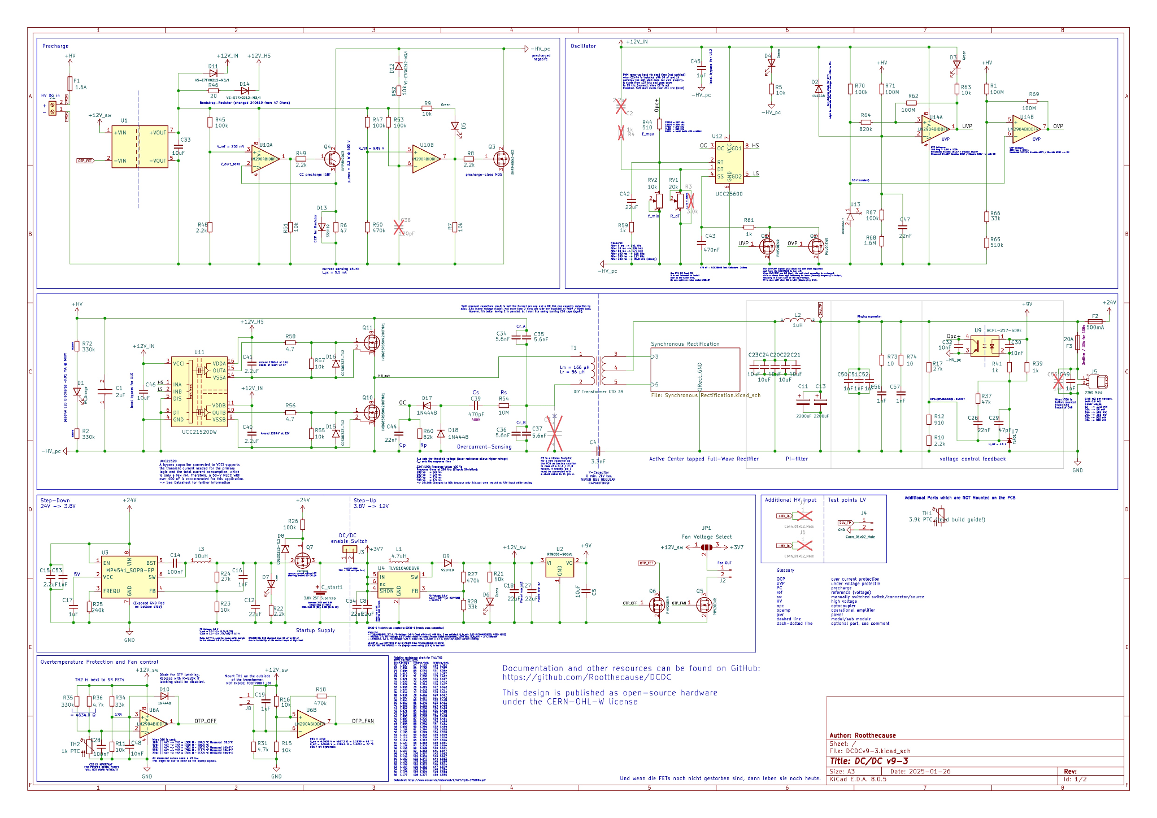
Schematic

Slide 16
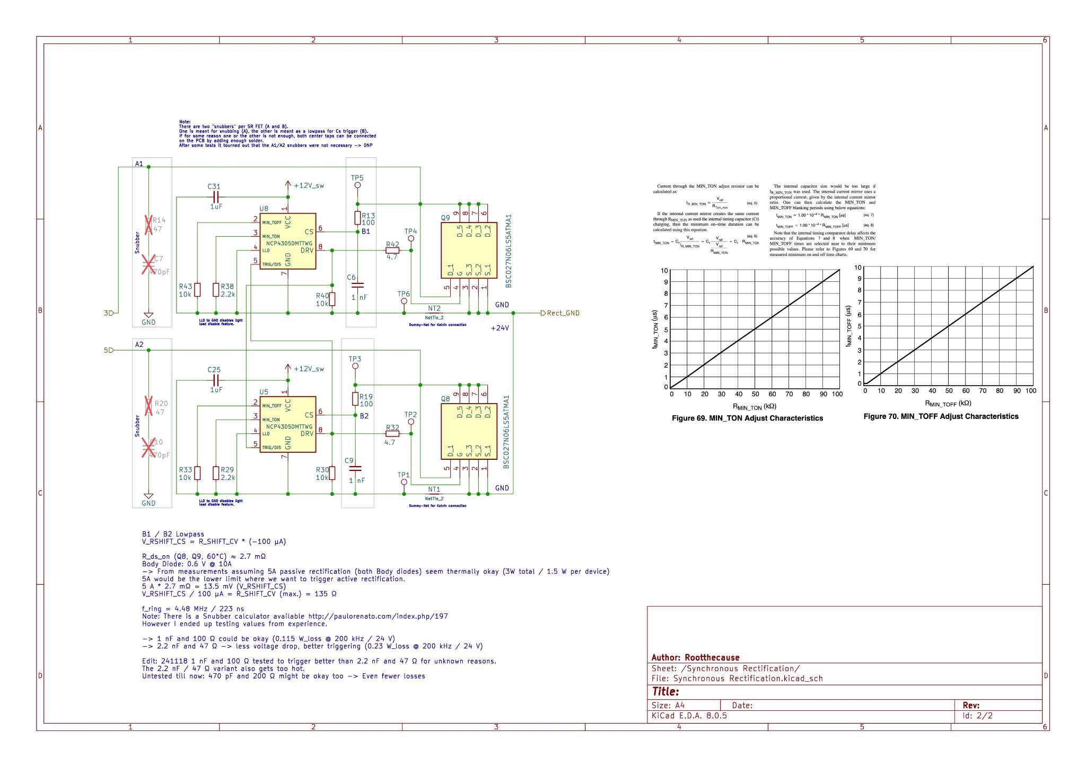
Schematic
(Rectification)

Slide 17
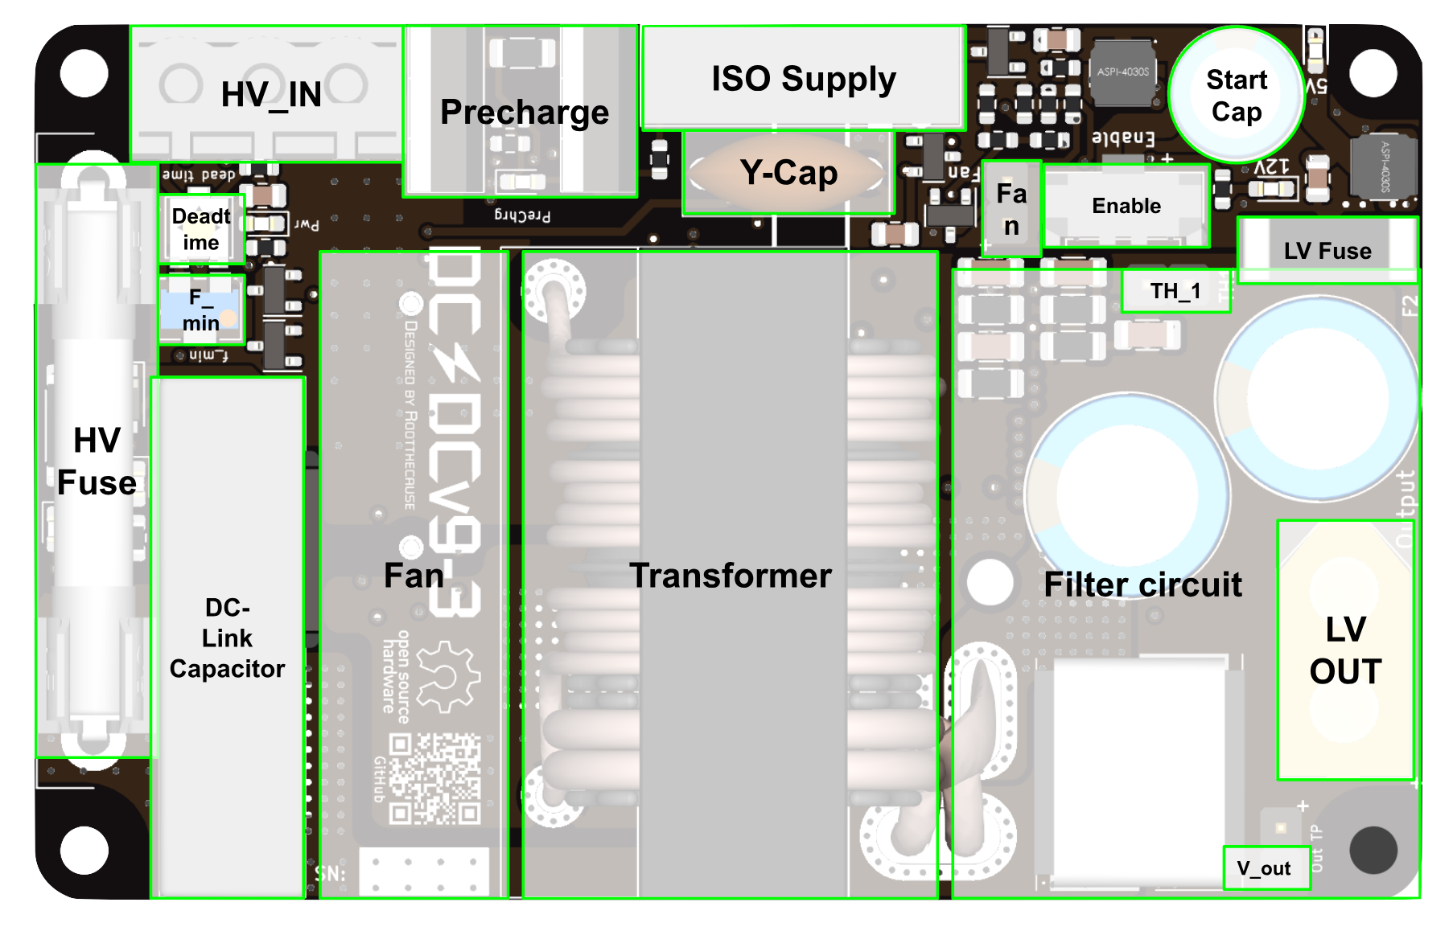
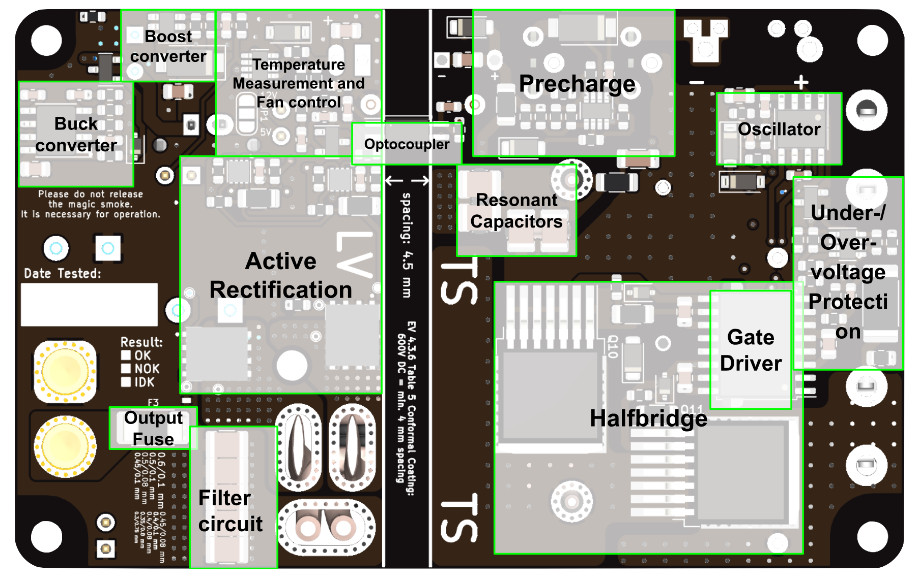
Design Overview
Top View
Bottom View

Slide 18
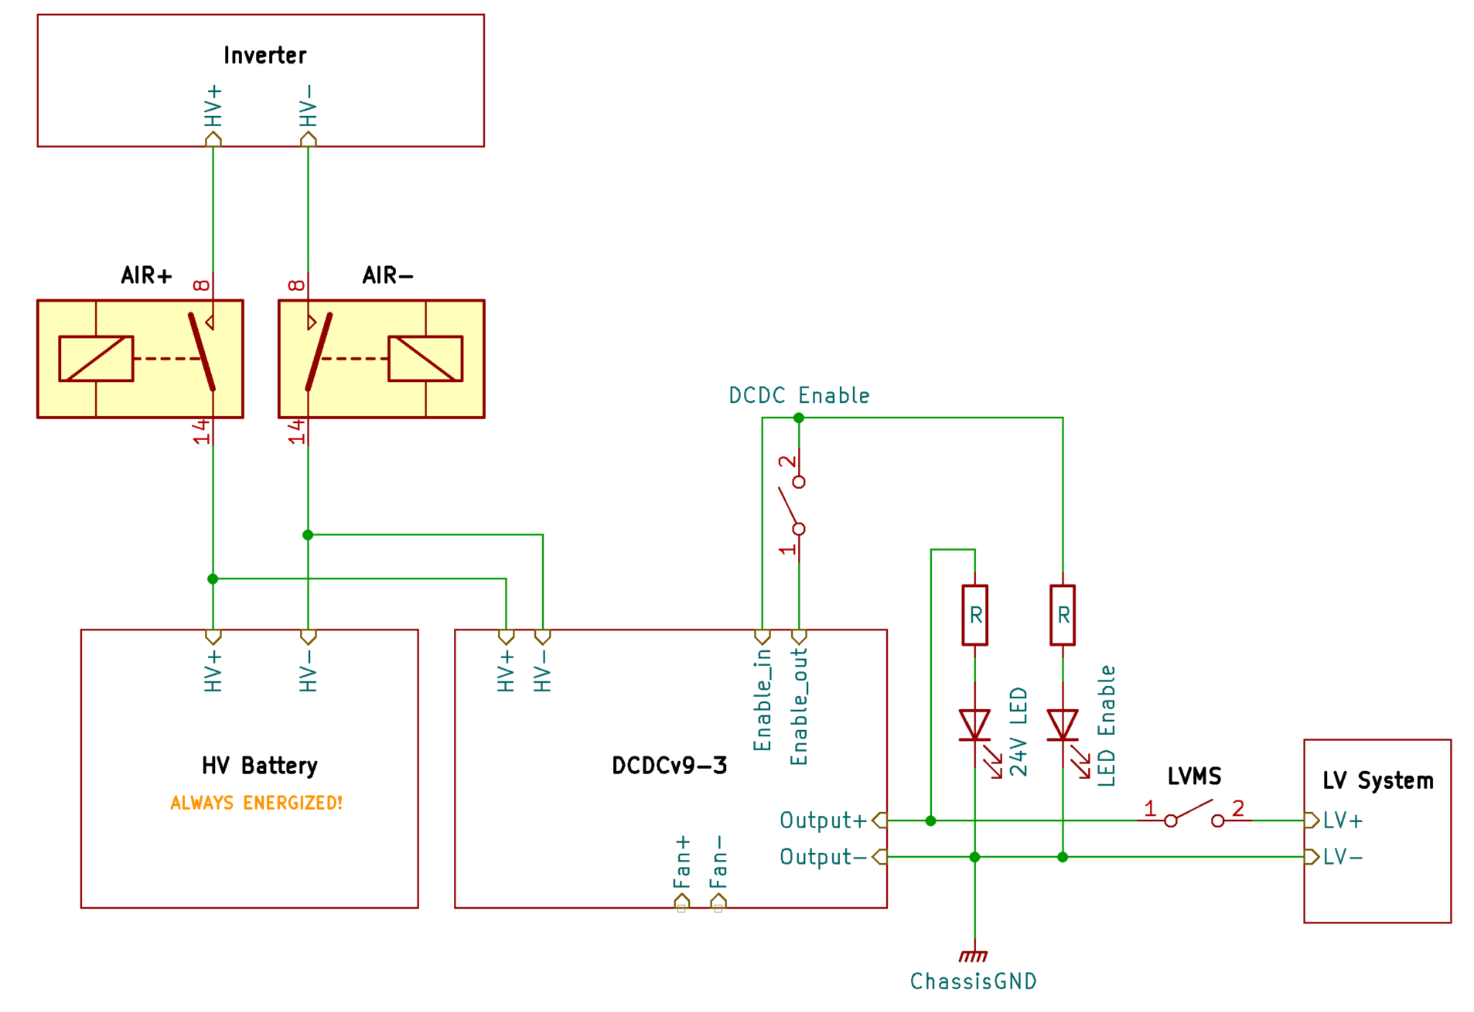
Connections

Slide 19
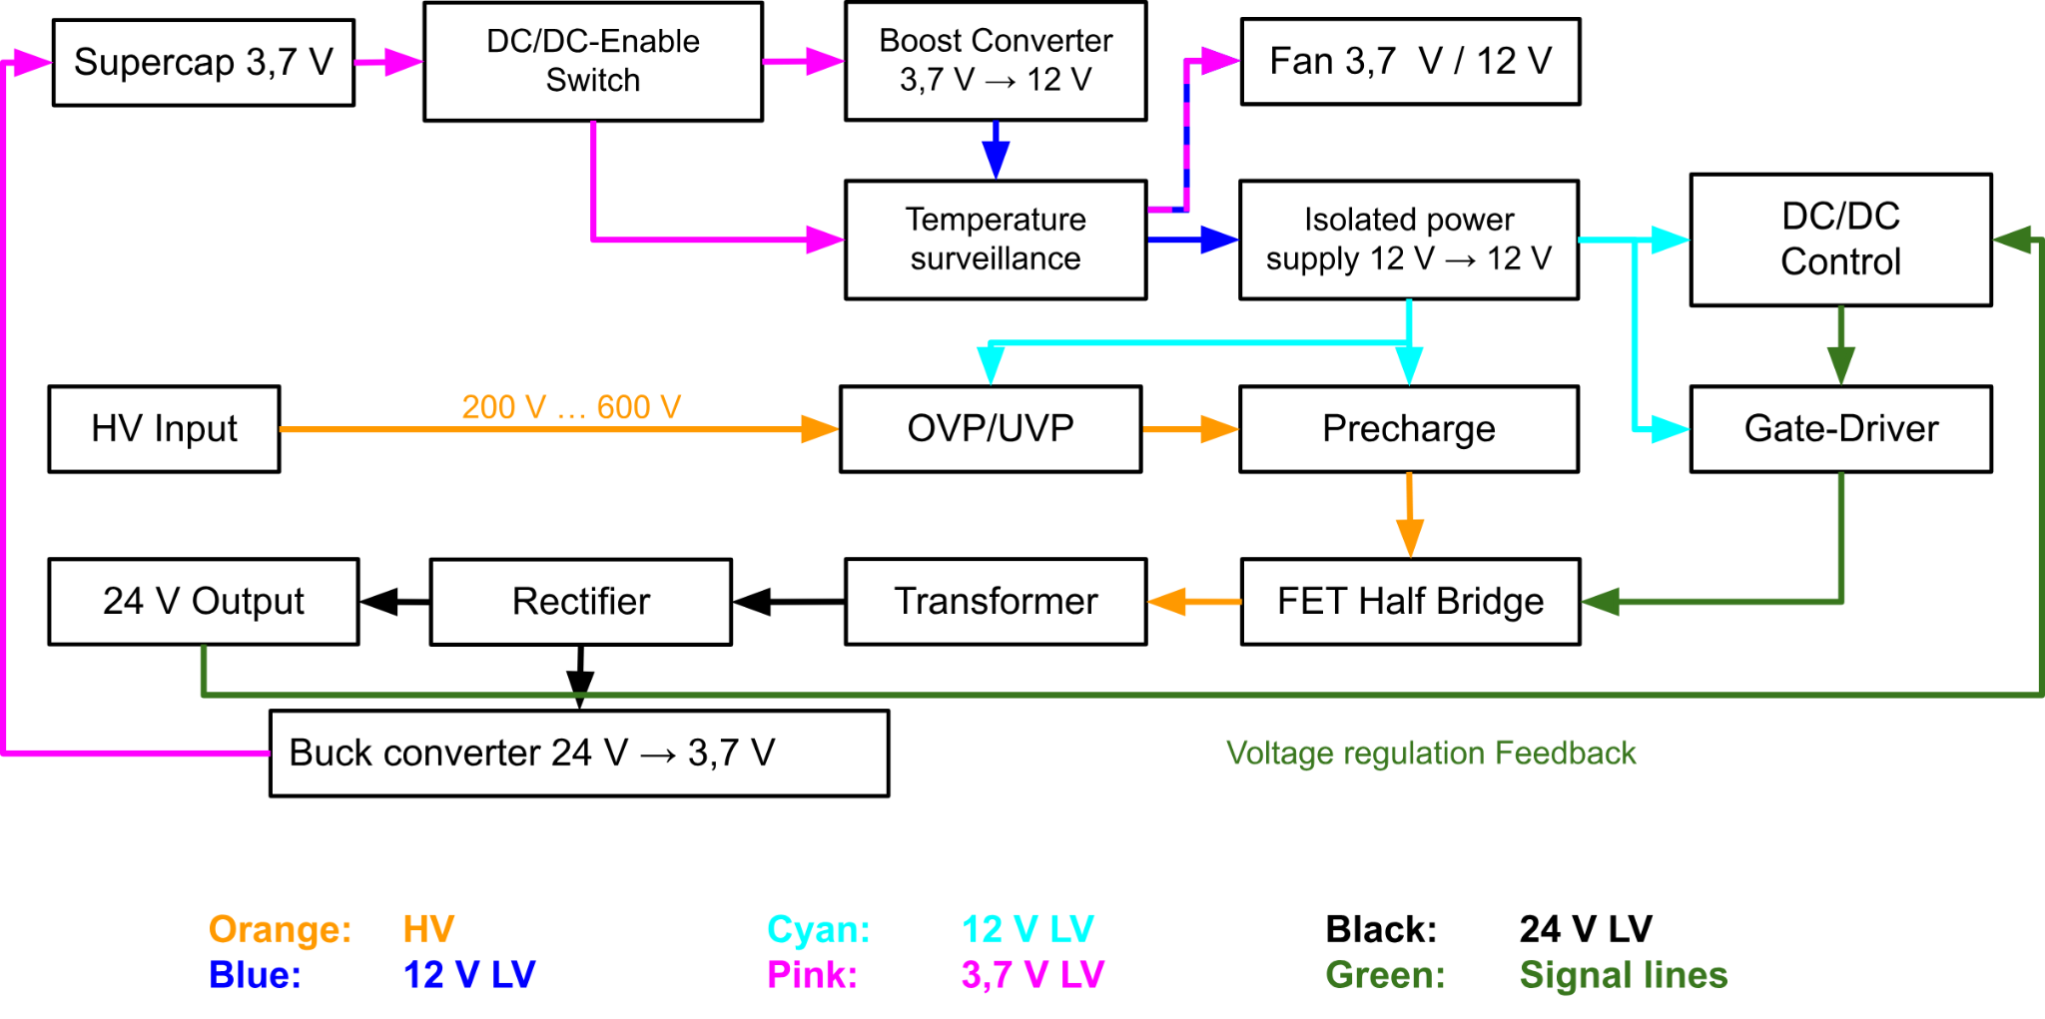
Signal Flow Chart

Slide 20
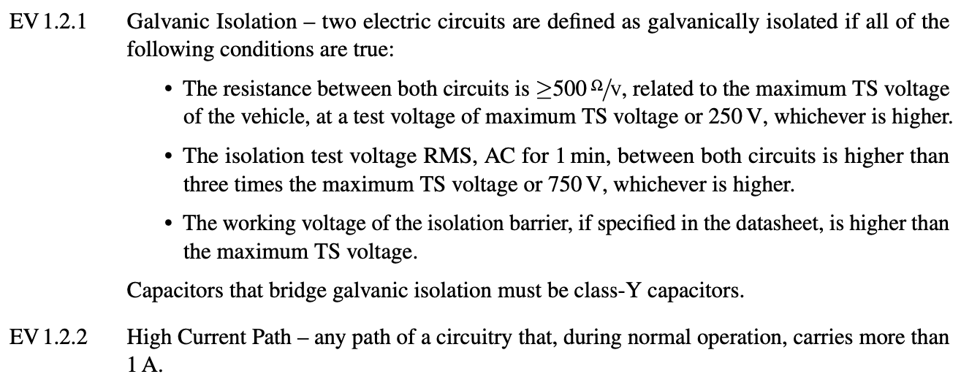
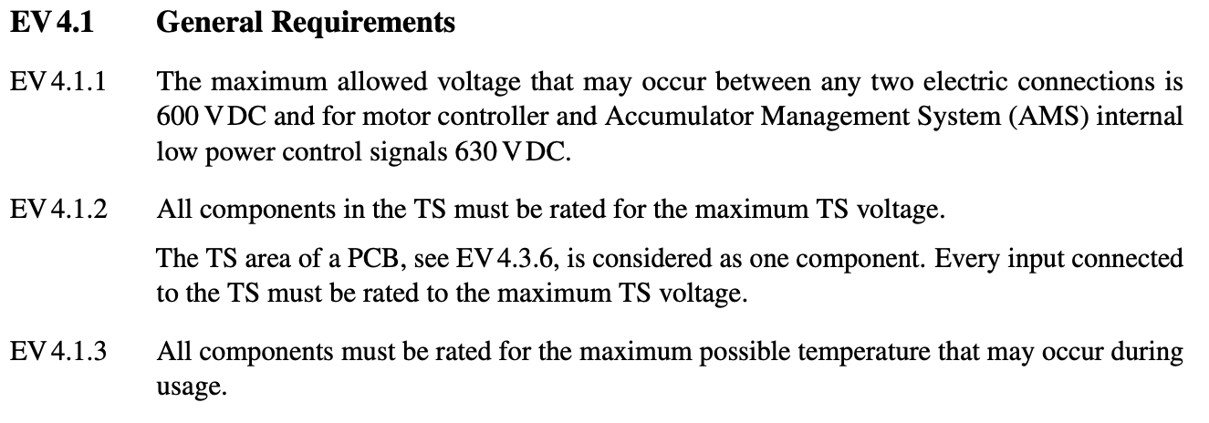
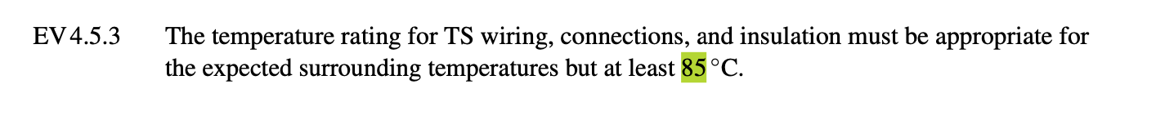
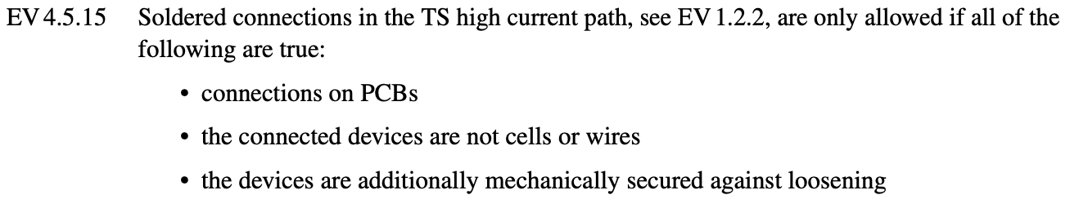
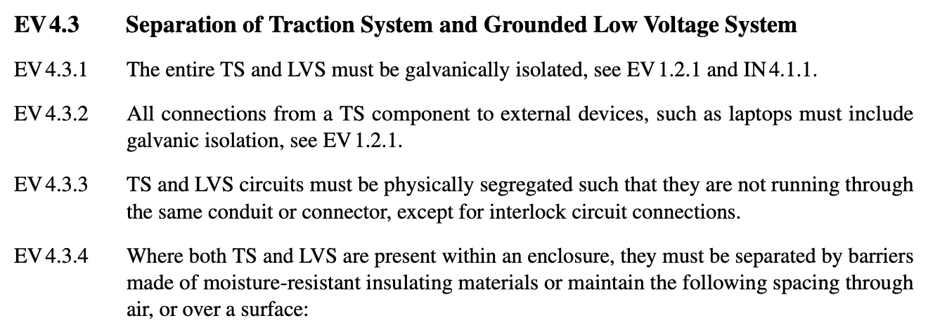
The DC/DC Converter was designed to comply with the following Rules (2025 v1.1)
Source: Formula Student Rules 2025 v1.1

Slide 21
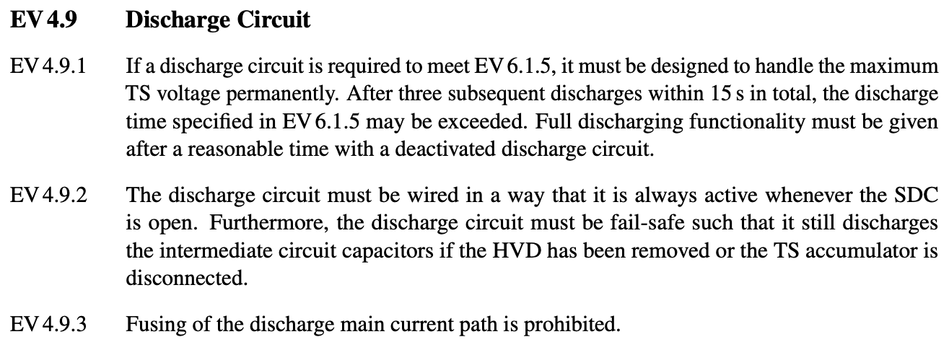
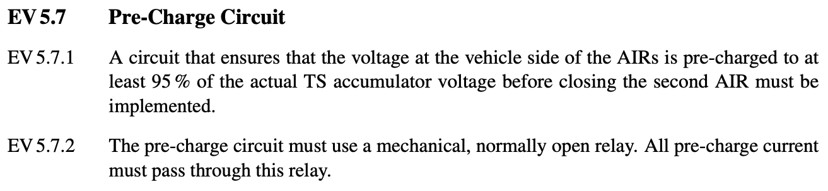
Further Rules were taken in to account, although they are not required for the DC/DC Converter.
Passive Discharge of DC-Link Capacitor takes 3.1 seconds at max. TS Voltage (600 V)
Precharge is Switched at U_input - 9 V
-> at min. TS Voltage (400 V) it is switched at 391 V which is 97.8 %
A Pre-Charge is not mandatory for the DC/DC, therefore MOSFETs are viable as Pre-Charge and Pre-Charge close.
Source: Formula Student Rules 2025 v1.1

